Slide 1
Using Supervised Learning Classifiers to Predict Student Success in School
Notes:
Good day, ladies and gentlemen. I'm going to present the process of supervised learning classifiers to predict students’ success in a course during a school year based on students’ social, and demographic data.

Slide 2
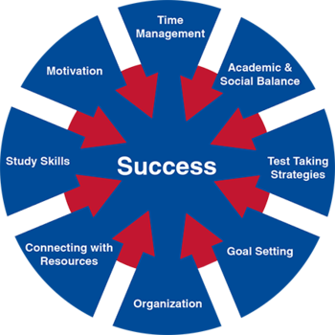
Topic
This study intends to model student achievement in secondary education using classification techniques to evaluate whether a good predictive accuracy could be achieved based on student grades, demographic, and social-related features.
The aim is to identify the key variables that affect students' educational success/failure, to better administer school resources, and to target the most vulnerable students based on their demographic and social characteristics.

Slide 3
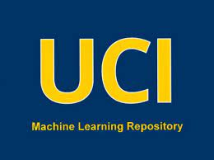
The DATASET
The dataset is Student Performance, donated by Pablo Cortez (2014), and published in UC Irvine Machine Learning Repository.
The dataset includes the student grades, demographic, social, and school-related features for Portuguese language courses in two Portuguese schools. The data was collected by using school reports and questionnaires.
The dataset contains 30 features and 649 instances.
Source: UC Irvine Machine Learning Repository
Link: https://archive.ics.uci.edu/dataset/320/student+performance

Slide 4
Knowledge discovery process
Exploring the dataset
Pre-processing the data
(Cleaning & Transformation)
Exploratory Analysis
(Identifying pre-processing and modeling methods)
Evaluating the model
Modeling Process
(Training & Cross Validation)
Missing Values
Duplicated Values
Features Reduction
Variable Transformation
Data Distribution
Data Imbalance
Correlation Analysis
Features Importance
Decision Tree
Random Forest
AdaBoost
Support Vector Machine
The best modeling setup
Predictive Performance
Descriptive Knowledge

Slide 5
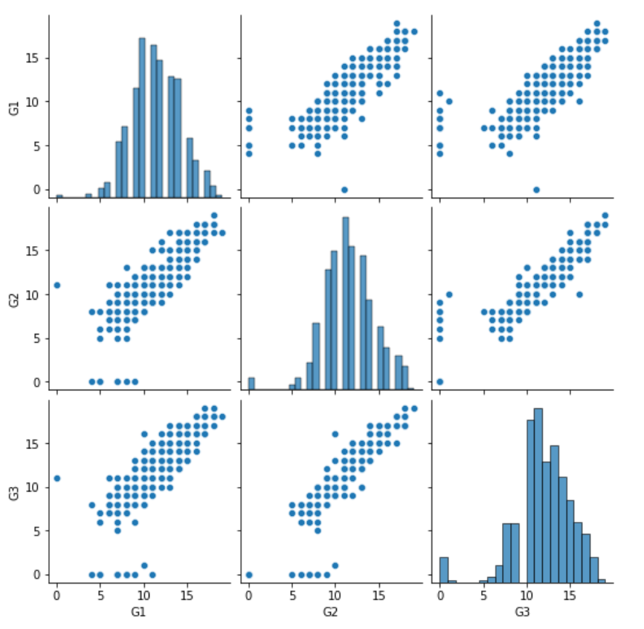
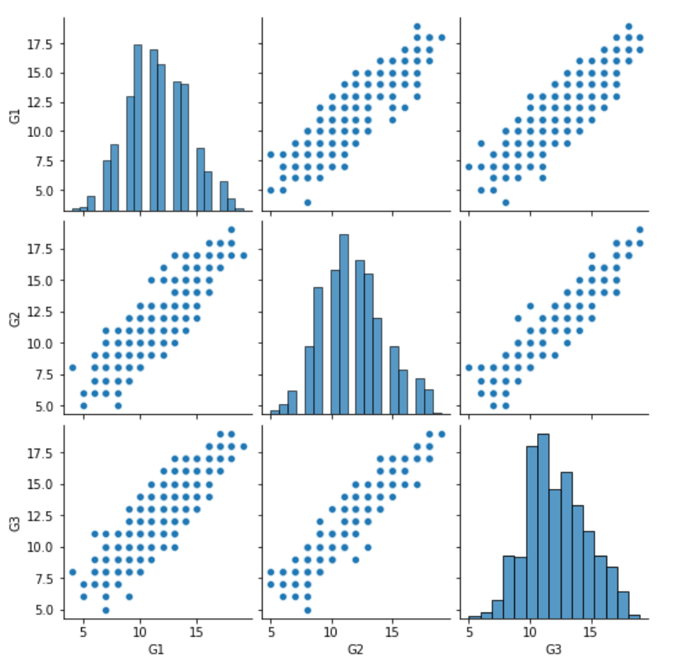
Data Pre-processing
Highlights:
No missing values.
No duplicated values.
Outliers were identified and removed using EllipticEnvelope with a 3% contamination.
Dropped two feature variables without predicting power for student success.
Dropped two target variables related to first-term and second-term grades.
Transformed nominal variables into multiple binary columns.
The target variable (G3) converted into a pass/fail (binary) class

Slide 6
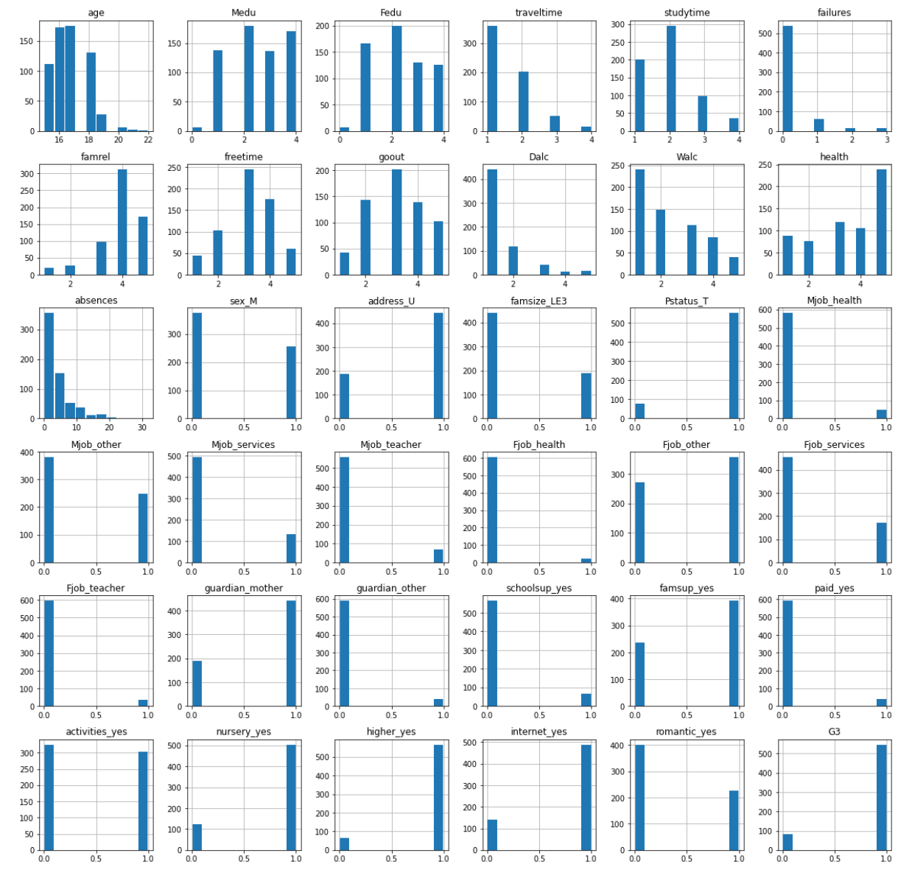
Exploratory analysis
Highlights:
Presence of Class Imbalance.
Correlated Analysis, most correlated features:
Past failures [failures]
Pursuing higher education [higher]
Mother education [Medu]
Number of absences from school [absences]
Weekly study time [studytime]
Feature Importance, top 5 important features:
Mother education [Medu]
Father education [Fedu]
Number of absences from school [absences]
Past failures [failures]
Weekly study time [studytime]

Slide 7
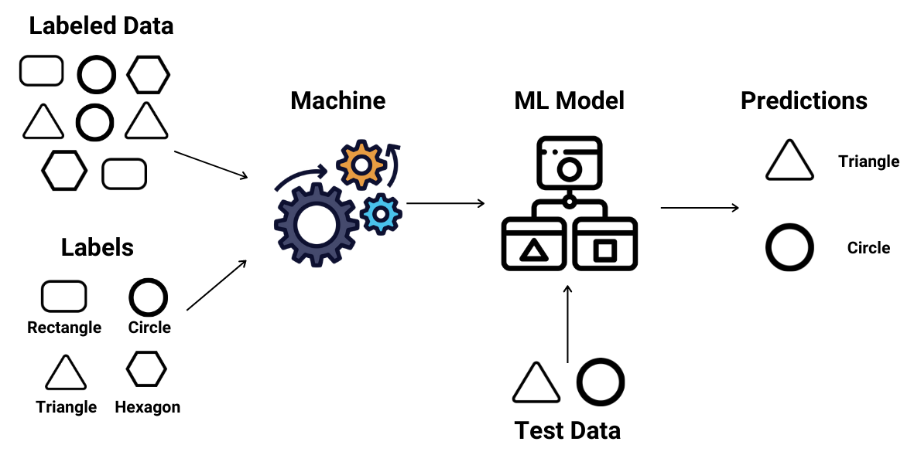
Modeling process
Highlights:
Setting up a pipeline with the following steps:
Standardization [StandardScaler, Normalizer]
Oversampling (RandomOverSampler, SMOTE)
Feature Selection (PCA, chi2, MI)
Cross Validation (Kfold, StratifiedKfold, ShuffleSplit)
Classification (DT, RF, AB, SVC)
612 different model setups evaluated using cross-validation and 3 scoring metrics: accuracy, precision and au_roc.
Best Model Setup, a Random Forest Classifier, achieved 86.3% accuracy, 87.6% precision, and 84.3% au_roc average across folds for the validation sets.

Slide 8
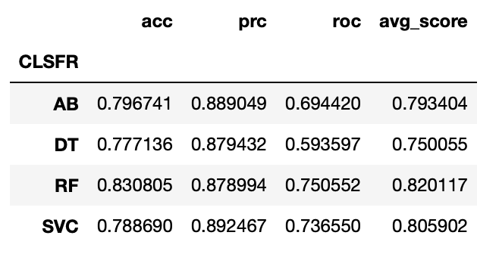
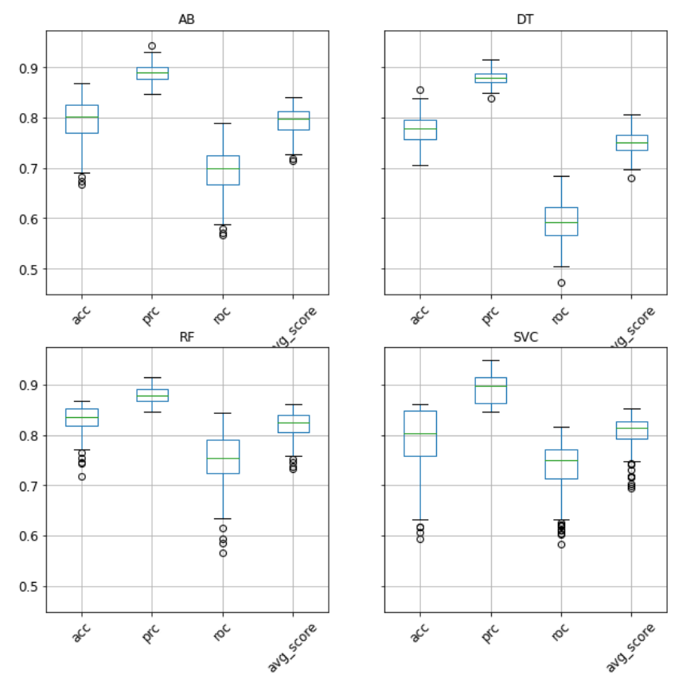
Results Predictive Performance
By Classifier:

Slide 9
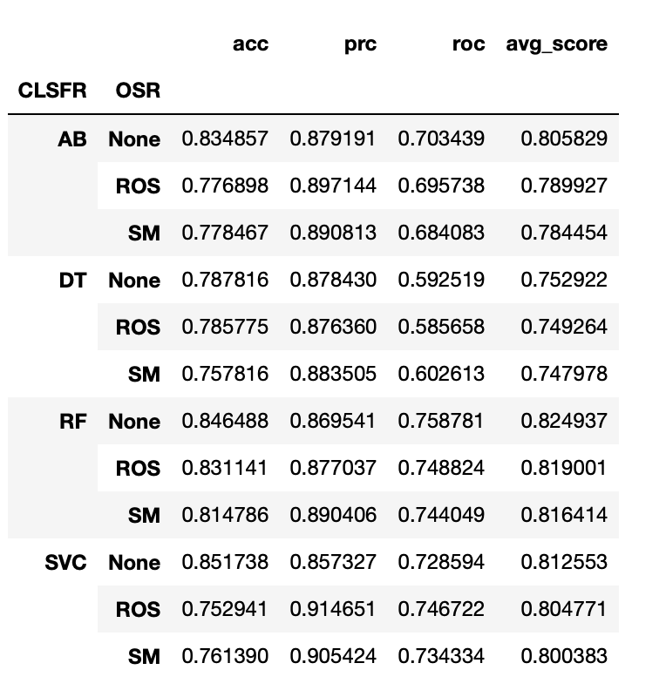
Results Predictive Performance
By Over Sampler:

Slide 10
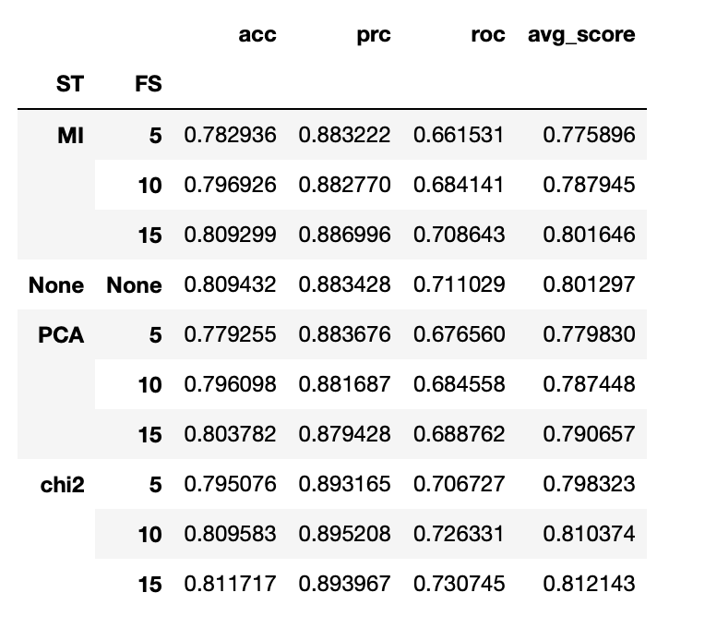
Results Predictive Performance
By Feature Selection:

Slide 11
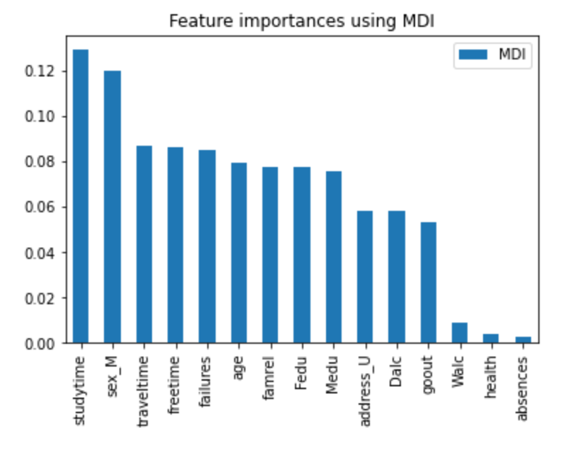
Results Descriptive Knowledge
Based on best model:

Slide 12
Conclusions
The results revealed that it is possible to predict student educational success over a school period using students' demographic, social, and other school-related data with an accuracy and precision of around 85%.
The Random Forest (RF) classification algorithm was the best classifier, followed closely by the Support Vector Machine (SVM) algorithm.
Mitigating class imbalance using oversampling techniques did not significantly improve the model's performance in distinguishing between the majority and minority classes.
In line with what was observed during the data exploration analysis, the most important factors in student educational success are study time, travel time, free time, past failures, family relationships, and parents' education.
Notes:
In conclusion,
Even though,

Slide 13
Thank you

